Slide 1

USER BEHAVIOR &
CYBERSECURITY RISK ANALYSIS SYSTEM

Slide 2
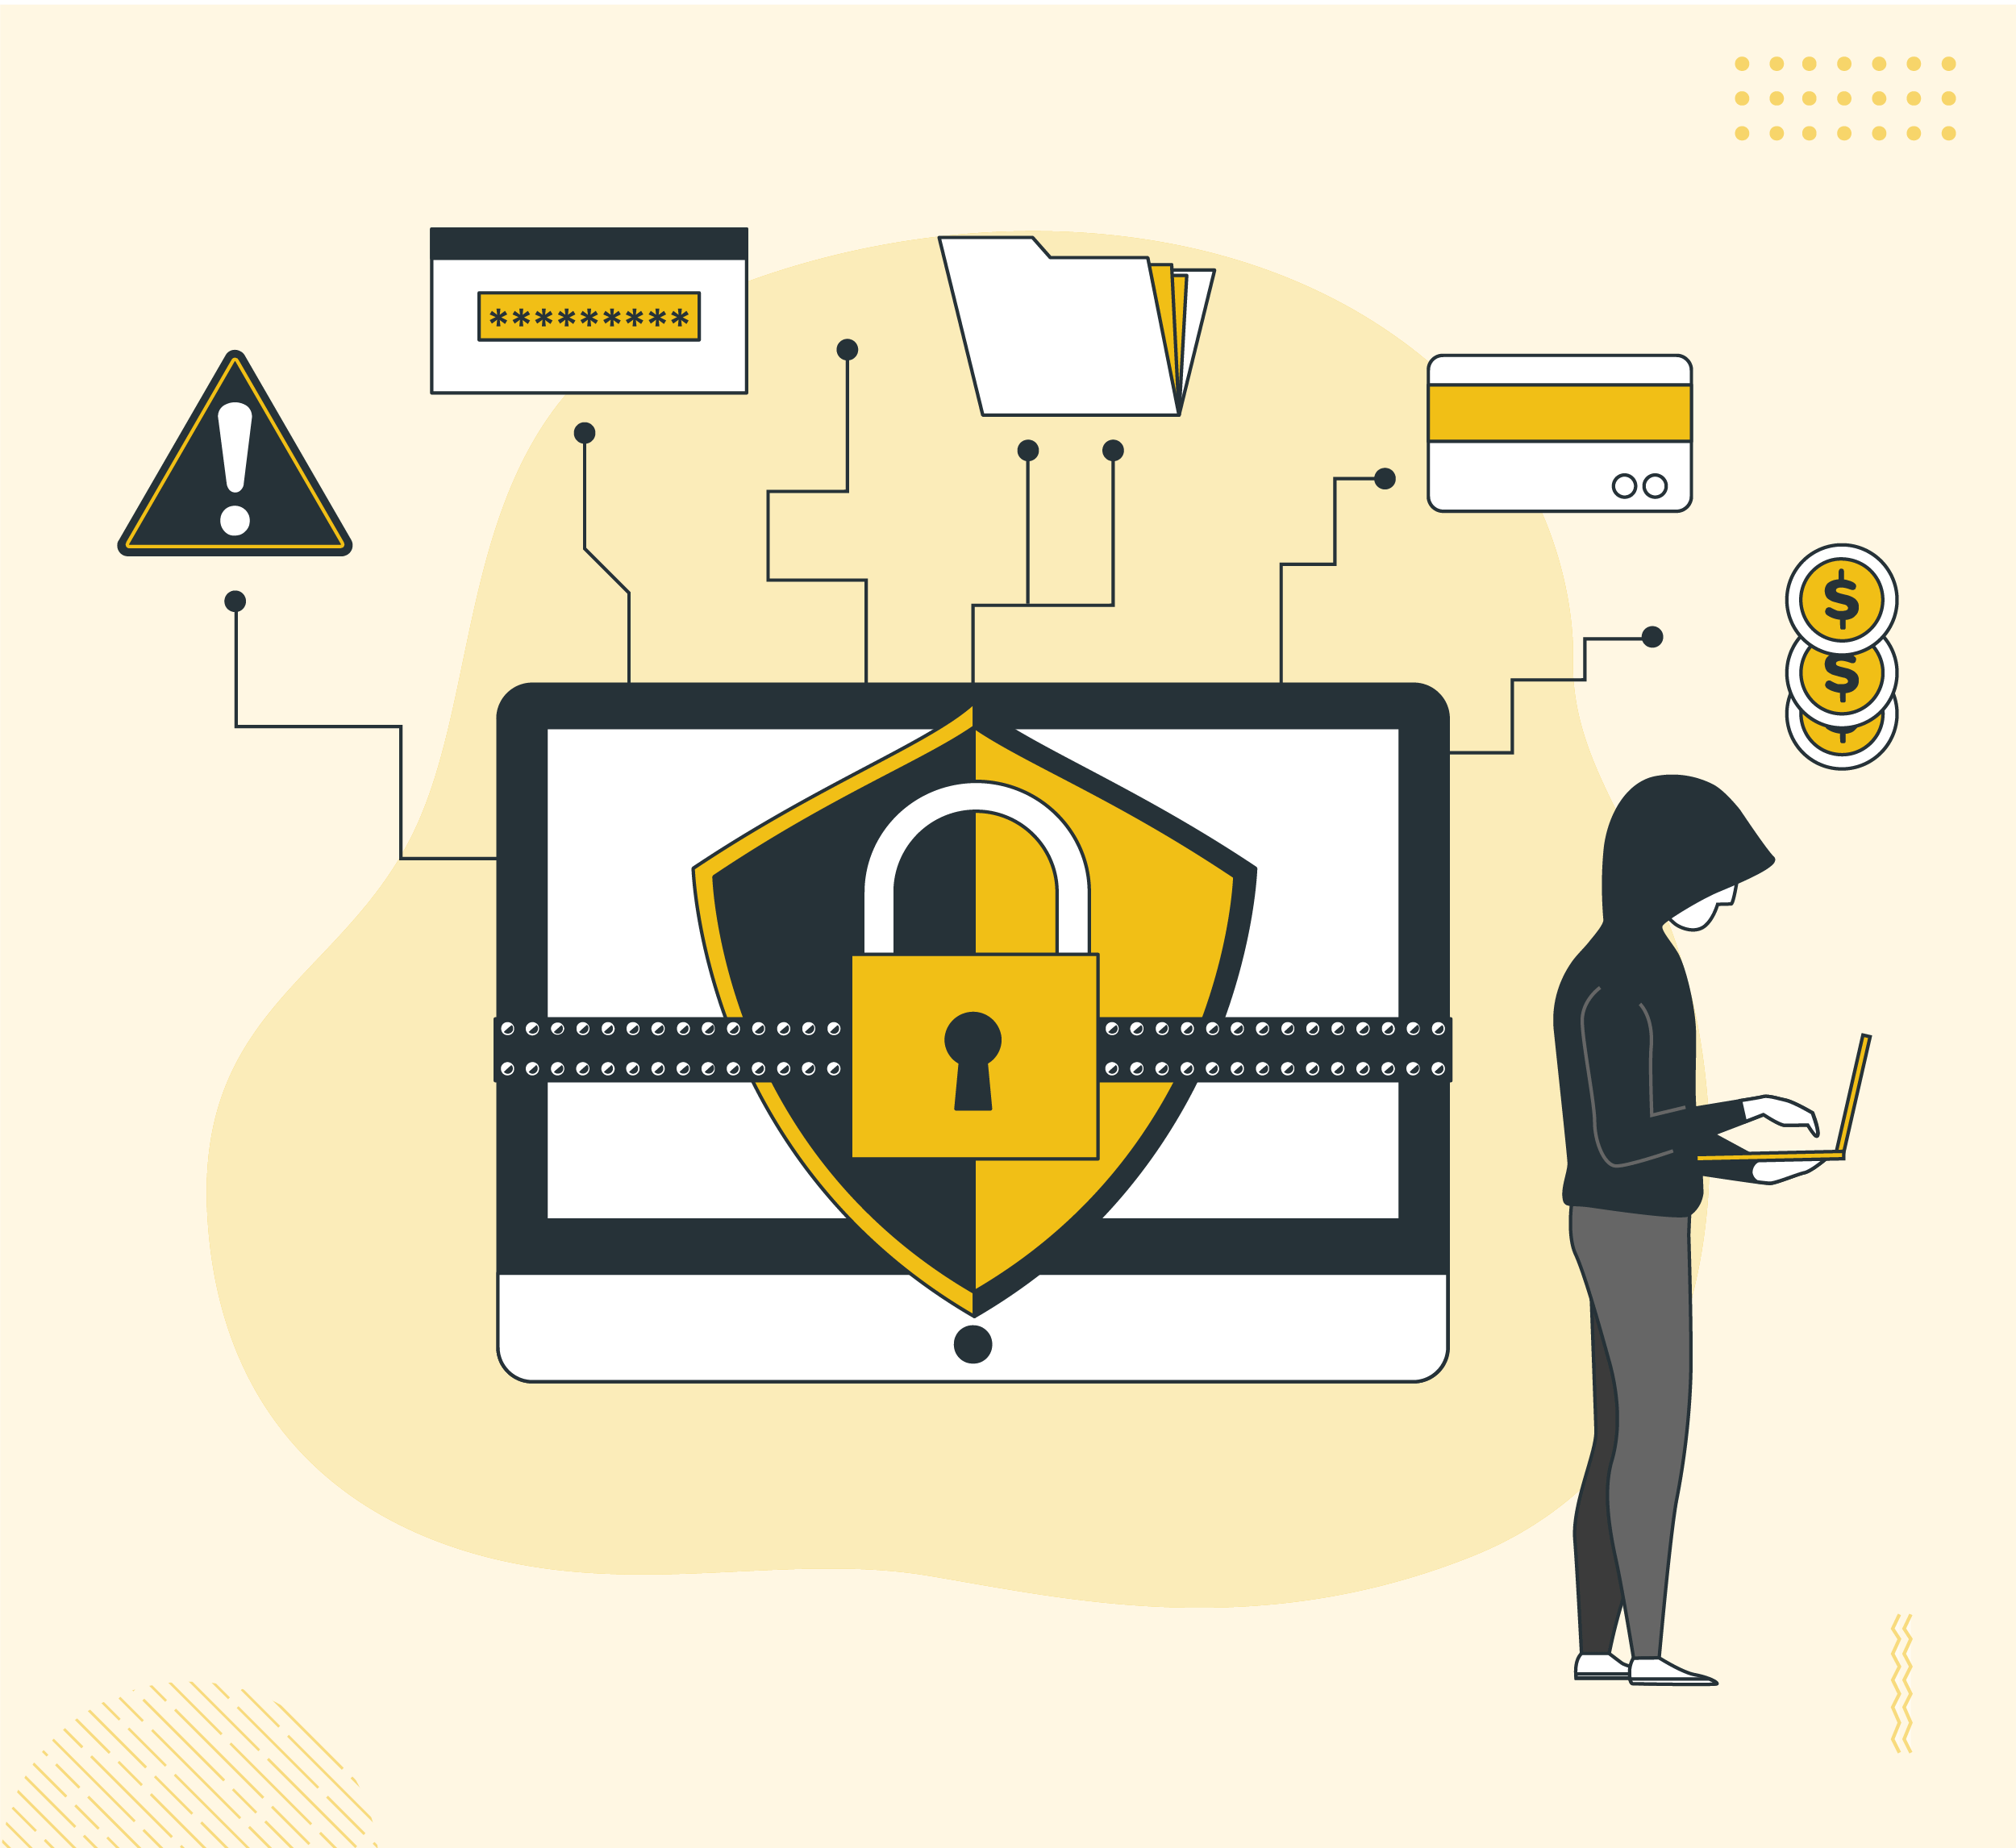
Tools and Technology used :
Python - For taking user input, connecting to the database, and performing risk analysis.
MySQL - For storing users, devices, login history, and risk-related data.
SQL - For querying and analyzing cybersecurity data.
Power BI - For creating dashboards and visualizing user behavior and security insights.
jupyter notebook - For developing and running the Python analysis.

Slide 3

Problem Statement :
Large amount of user login data is difficult to monitor manually.
Suspicious login activities can be missed.
New devices and unusual locations may indicate potential security risks.
There is a need for an automated system to analyze user behavior.
The system helps identify potential risks and provides security recommendations.
The User Behavior & Cybersecurity Risk Analysis System aims to solve this problem by analyzing user activity, devices, and locations to identify unusual behavior and provide security insights and recommendations.

Slide 4
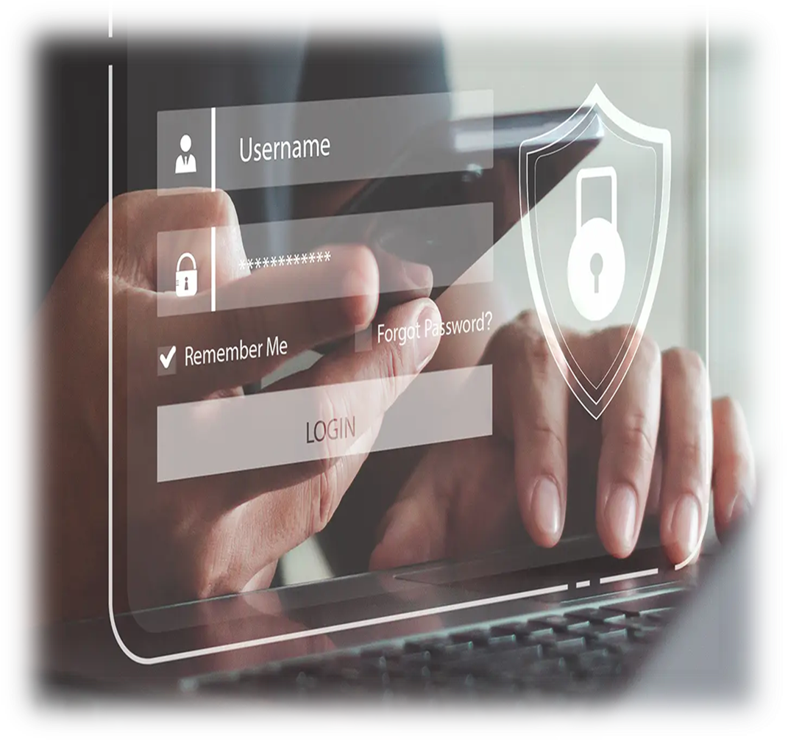
Project Objectives :
To analyze user login activities and patterns.
To monitor user, device, and location information.
To identify unusual login behavior, such as logins from new devices or unusual locations.
To provide security recommendations based on the identified activity.
To visualize login and risk-related information using Power BI dashboards.
To use Python and SQL for automated data processing and analysis.

Slide 5
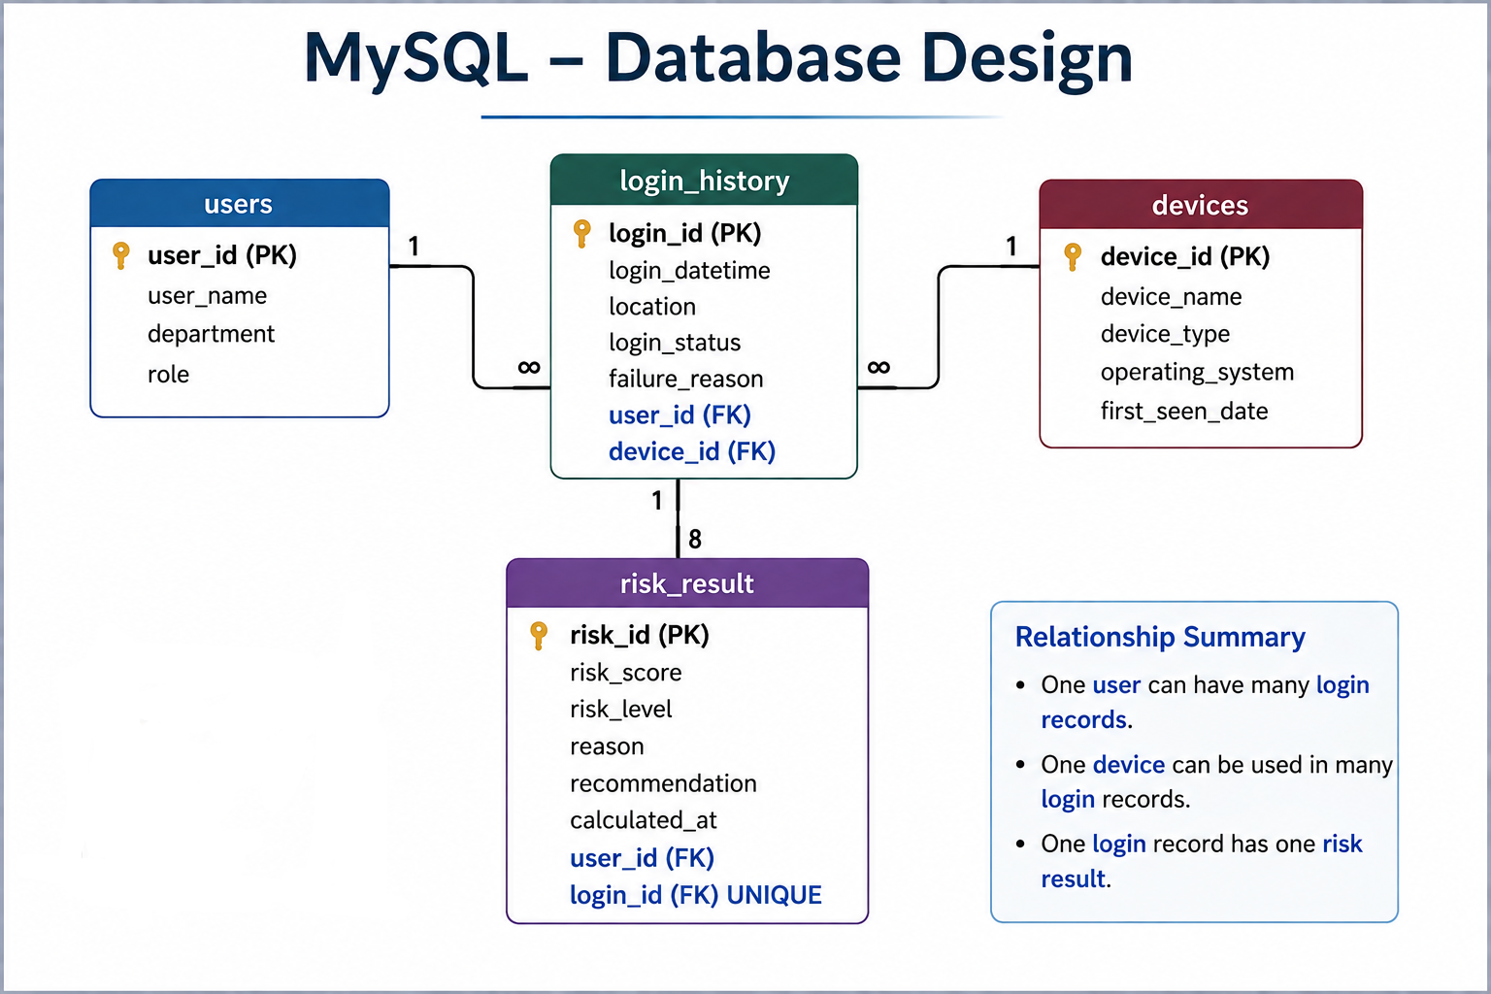
Database Design
Overview :
Users: Stores user details such as User ID, name, department, and role.
Devices: Stores device information such as device name, type, operating system, and first-seen date.
Login History: Stores Records of each login attempt along with date/time, location, status, user, and device.
Risk Result: Stores the result of each login activity like risk level, reason, and recommendation for

Slide 6
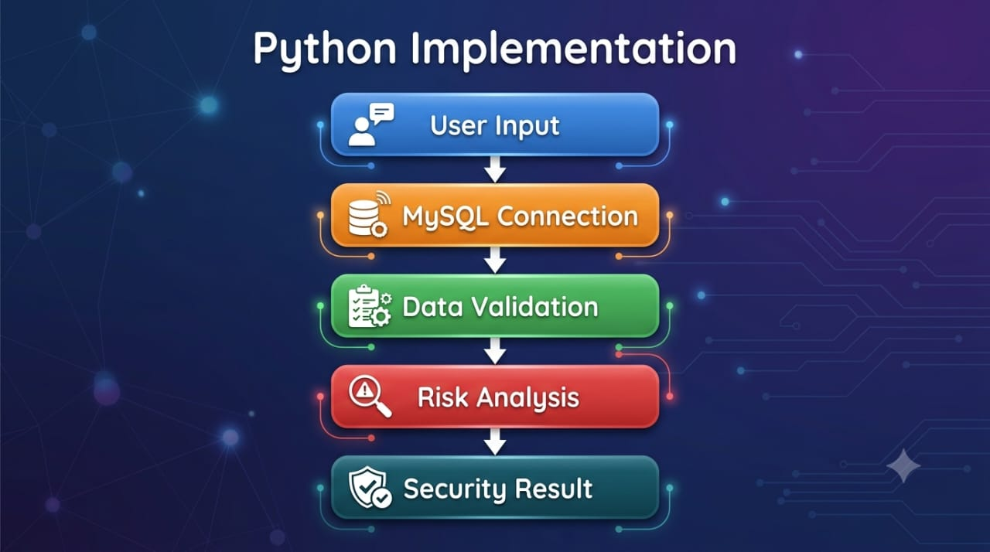
Python Implementation :
The system takes the required login details from the user.
1. User Input
User enters User ID
User enters Location – used to check whether the login location is normal or unusual for the user
User enters Device Name
2. Database Connectivity
Python connects to the MySQL database, It retrieves the required information.
3. Data Validation & Analysis
Checks whether the entered device is already registered.
Identifies whether the device is new for that user.
4. Risk analysis
Based on these , the system calculates a risk score
The score is calculated by checking the user's current login behavior against their previous login history.
According to the risk score, the system assigns a risk level such as Low, Medium, or High. The system also identifies the reason for the risk.
5. Security Result
Finally, based on the risk level, the system provides a recommendation, such as allowing the login, monitoring the activity, or taking further security action.

Slide 7
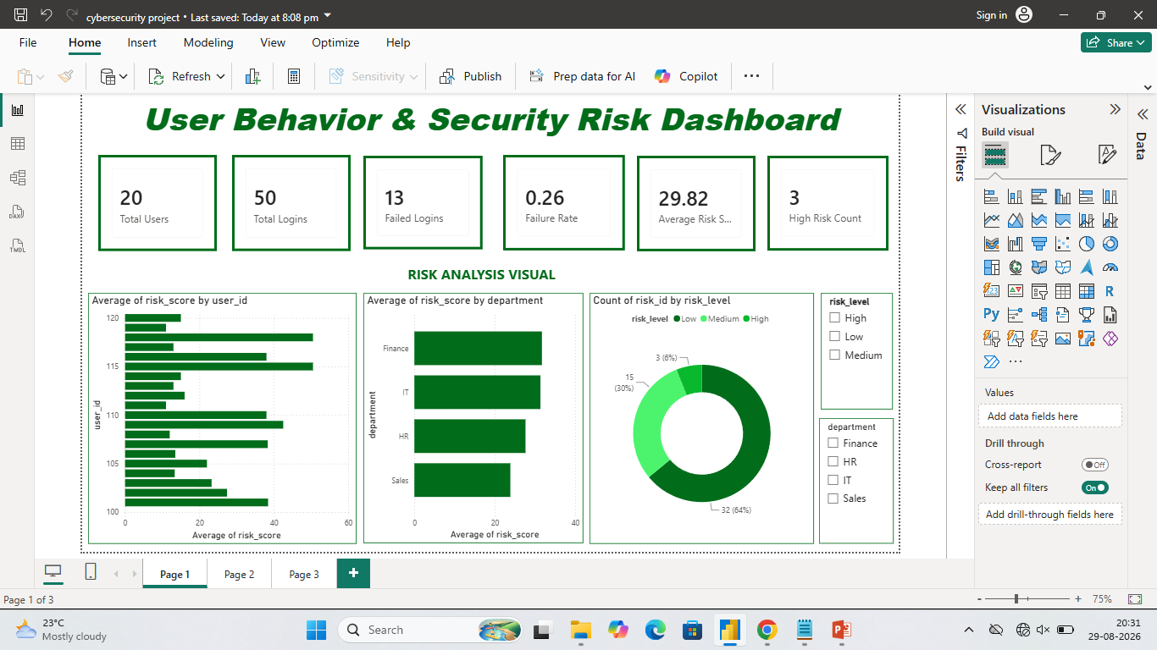
Key Insights from POWER BI Dashboard :
Provides a clear view of overall user behavior.
Identifies unusual login patterns.
Helps monitor new or unfamiliar devices.
Highlights locations with frequent login activity.
Supports cybersecurity monitoring and decision-making.

Slide 8

Future scope :
The future scope of our project is to make the system more intelligent and real-time. Currently, our system analyzes user login behavior, locations, devices, and login activities using SQL, Python, and Power BI.
In the future, we can integrate Machine Learning to automatically detect abnormal user behavior and suspicious login patterns. So ML would make our system more adaptive and capable of detecting unknown anomalies. We can also add Multi-Factor Authentication. This can help organizations detect potential security threats earlier and improve their overall cybersecurity.

